Slide 1


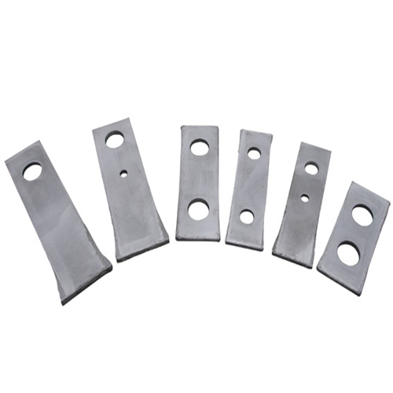
Introduction of Shanbao Machinery’s Hammer Beater

Slide 2
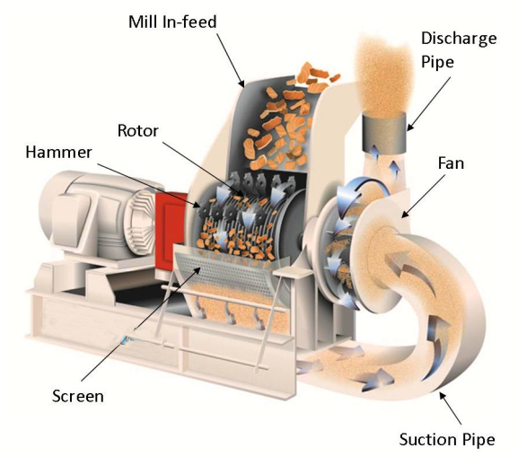
Application of Hammer Beater
The Hammer Beater is a core consumable component of the Hammer mill and plays a significant role in crushing granular or block raw materials.
Hammer mill crushing efficiency and crushing quality is greatly influenced by the shape, specification, material, density, arrangement and manufacturing process of the hammer mill beater.

Slide 3
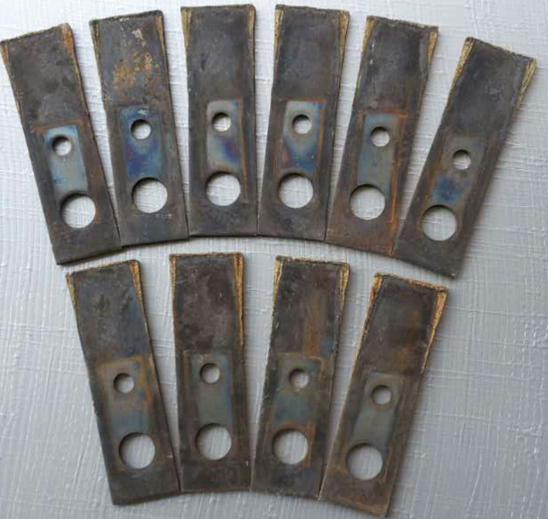
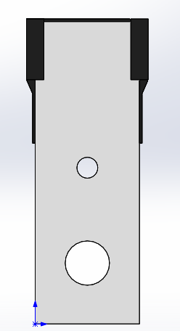
The structure of hammer beater
Abrasion-proof material
Substrate
Pin hole

Slide 4
Material of substrate
Generally, there’re two kinds of material as the substrate:
❆Option A:
High manganese steel: 65Mn (spring steels) The material has high cost and good wear resistance, but the heat treatment is easy to deform and crack resulting in fracture in use, so it is difficult to apply successfully in actual production.
❆Option B:
Low manganese steel:16Mn (Q345 ) It has good mechanical properties and economy, the surface can be carburized to improve the hardness to achieve wear-resistant effect, the core hardness is low toughness is not easy to break when used, and the surfacing performance is good, so it is widely used.

Slide 5
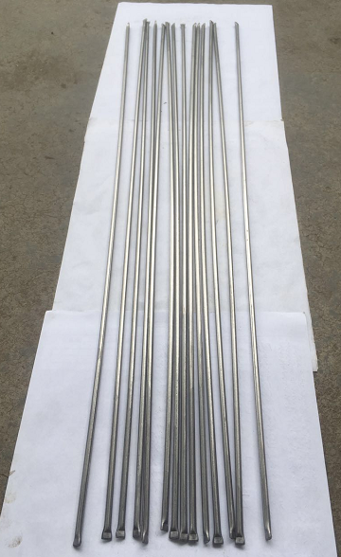
Material of Abrasion-proof
Casting tungsten carbide ：
By flame or argon arc welding and surfacing of substrate welding, the process is mature, reliable, flexible, and widely used. The hardness of surfacing layer can reach 62-67HRC.

Slide 6
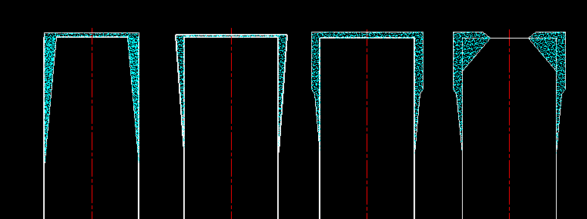
Choice of hammer beater’s surfacing welding
Type A Type B Type C Type D
Type B is the mainstream of the market, straight step and reinforced have a good wear life, but the procurement cost is higher, the ton consumption cost is lower!
The length and thickness of the surfacing layer technically depend on the wear pattern of the material to the hammer beater.

Slide 7
The main manufacturing process
Cutting &Punching
Marking
Overlay
Cladding
Carburizing Quenching
Tempering
Balance Weight
Packing
Inspect

Slide 8
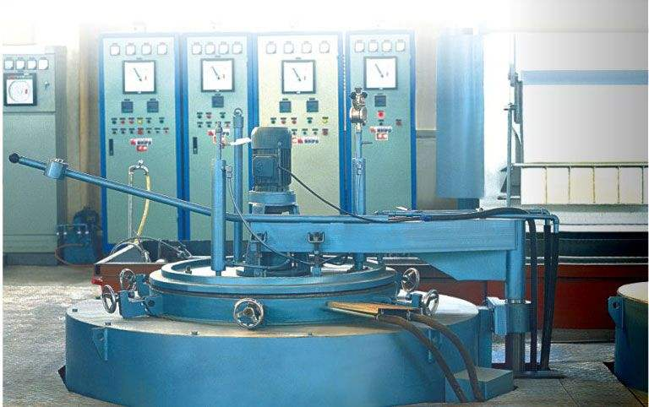
Heat treatment of hammer beater
1. Carburizing and quenching
2.Tempering

Slide 9
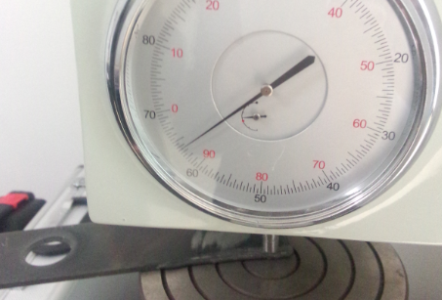
Inspect of hammer beater

Slide 10

The output than your imagination if cooperate with Shanbao Machinery!

